Slide 1
Influencing Outcomes
Active Social Engineering

Slide 2
What is “Active” Social Engineering?
Active Social Engineering is a dynamic process in which you are engaged with one or more other parties requiring you to constantly adapt, using various techniques, and, varying levels of these techniques in an attempt to leverage the outcome of the encounter to one that is desirable or beneficial to you.
How is this different from “standard” social engineering?
It doesn’t stop; this is a process involving multiple encounters and often multiple parties.
Starts with an in-person conversation, one to one or one to many.
The initial outcome influences subsequent outcomes.

Slide 3
Background
Rick Givens
BS, Dual Major: Computer Information Systems and Management Information Systems from Columbia College of Missouri
Studying for MS in Computer Science from Lewis University, focusing on Security
More of an InfoSec enthusiast
Previous experience in Law Enforcement and Physical Security
Marine Security Forces, Diego Garcia, British Indian Ocean Territory
Physical Security/Executive Protection Specialist, Southern Poverty Law Center, Montgomery, AL
Police Officer, Department of Defense, NAS Jacksonville, and NAVAIR Orlando, Florida
Federal Air Marshal, Department of Homeland Security, Chicago Field Office

Slide 4
My Lovely Assistant, Igor
Brendan Finegan
My cohort in research and co-founder of our blog Shamrock Security (yes, we are both Irish)
Fifteen years of IT experience, mostly self taught, focusing on hardware and networking
Independent contractor, with various clients among local municipalities, law offices, and small businesses
Will be advancing the presentation, and assisting in “The Experiment”

Slide 5
What Is “The Experiment?”
During this presentation, we will be engaging in a social experiment to demonstrate how these techniques work, and how they may be applied in a casual setting
At the end of the presentation, we will discuss what our desired outcome is and how we influenced the outcome
A bit of self-honesty is needed here, no one will call you out
If you guess the goal of the experiment, please keep it to yourself
If you object to the experiment, now would be the time to leave it begins with the next slide

Slide 6
Our Objective
To examine human communication and develop techniques to influence the outcomes of interactions; to detect when these techniques are being used on you.
This is a culmination of several skills and sciences
The use of body language
Listening skills
Auditory clues; changes in pitch, tone, or the speed of speech
Cultural understanding
Logic
Psychology
Sociology
Empathy (whether you truly have it or not)

Slide 7
Why is this important?
To become better communicators
To shape the outcome of interactions with others as necessary (Active Social Engineering)
To detect when these tactics are being used, and counter them to avoid being influenced by others (counter social engineering)
Develops critical thinking skills (understanding motivations)
Falls under the category of soft skills, which are in demand by employers

Slide 8
Soft Skills Are In Demand
"In many cases, the wrong people are leading security awareness programmes or lack the training they need to be successful. The majority are from highly technical backgrounds and lack skills such as communication and an understanding of human behaviour."
Lance Spitzner,
Director, SANS Institute
April, 2015

Slide 9
A Word of Caution
There is no “hard and fast rule” for communication or social engineering; no technique is guaranteed 100% measurable success.
These are guidelines that, when coupled with common sense and observation, may provide you with the means to achieve a goal.
Factors such as the level of intelligence, or “shrewdness” of the other party, as well as cultural differences, prejudices and perceived social standing all play a role. Remember when I mentioned Sociology and Psychology?
Do not use these techniques on your peers. There is a very good chance that they will realize what you are doing, and be offended by it. They may even turn the tables on you.

Slide 10
Communication Starts With The Eyes
In all personal (meaning, in-person) communications involving two or more, the first point of contact is visual
One person visually engaged with the other, or both persons looking at one another
This is when we define our opinion of the other person or persons
Snap judgements and character assessments are the result of outward appearance and mannerisms
It takes several attempts to leave a good impression, but a bad impression is easy to achieve
Your appearance will play a part

Slide 11
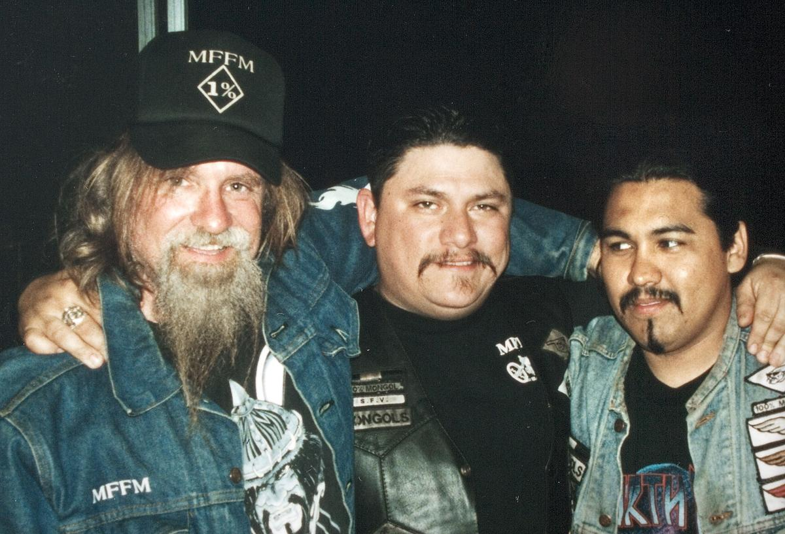
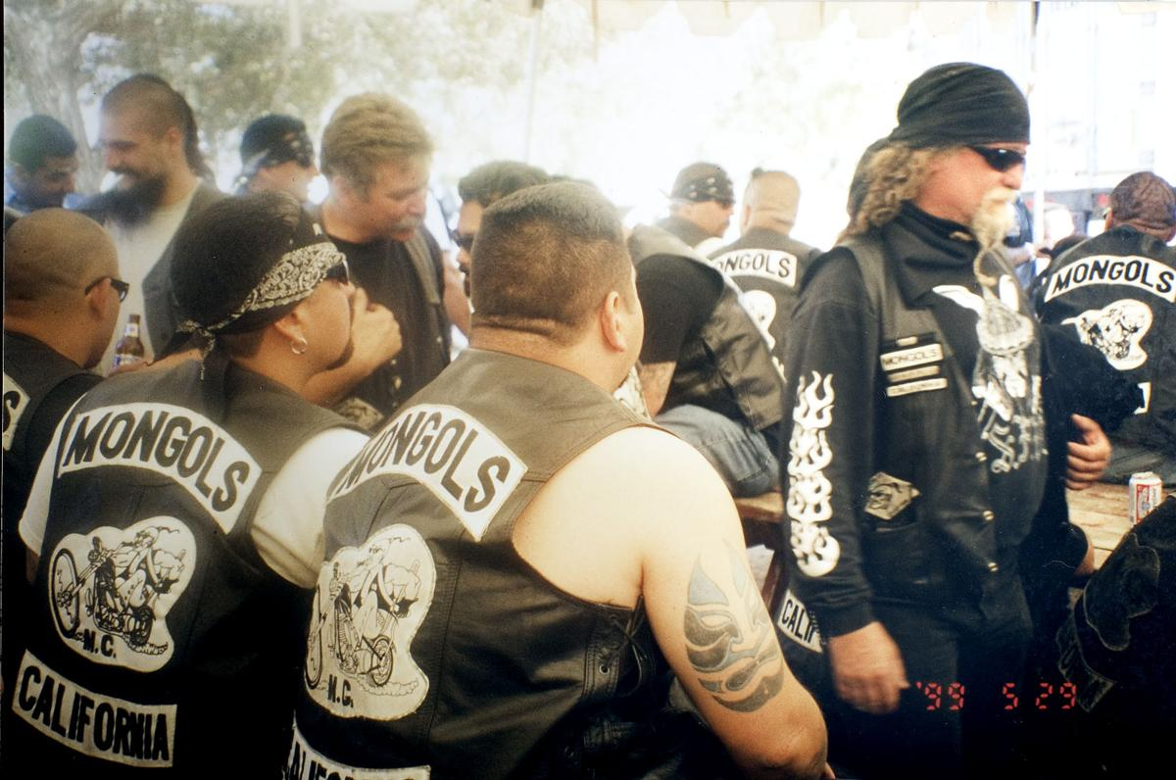
While We Are Discussing Appearance, What Do You See Here?
Greensboro News and Record, 2005

Slide 12
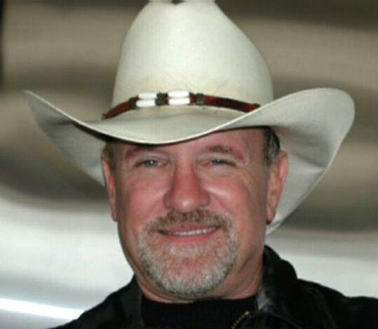
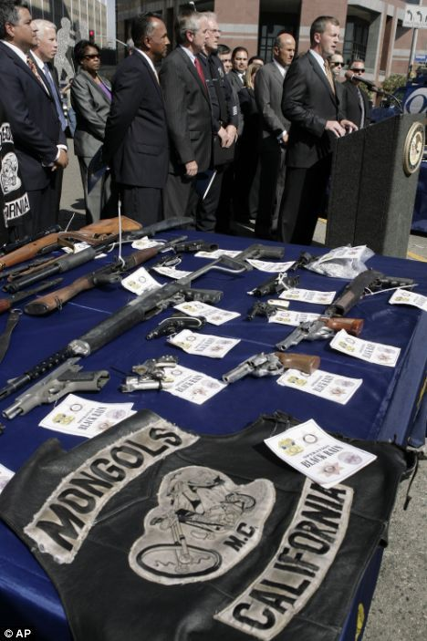
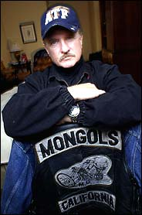
How About Now?
ATF Agent William Queen spent 28 months undercover with the San Fernando Valley Chapter of the Mongols, an outlaw biker gang consisting largely of Hispanic members, and rose to the rank of Chapter Vice President
Queen’s time undercover led to the arrest of 54 members across 4 states, and the conviction of all but one
The Mongols have since expanded to 14 states and 10 countries (and were infiltrated two more times)

Slide 13
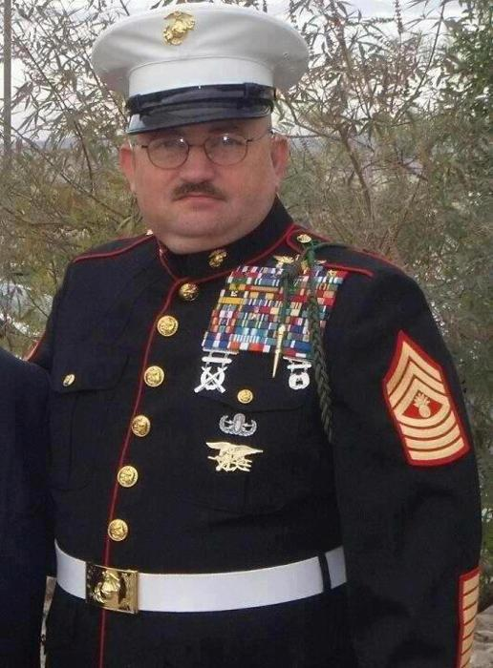
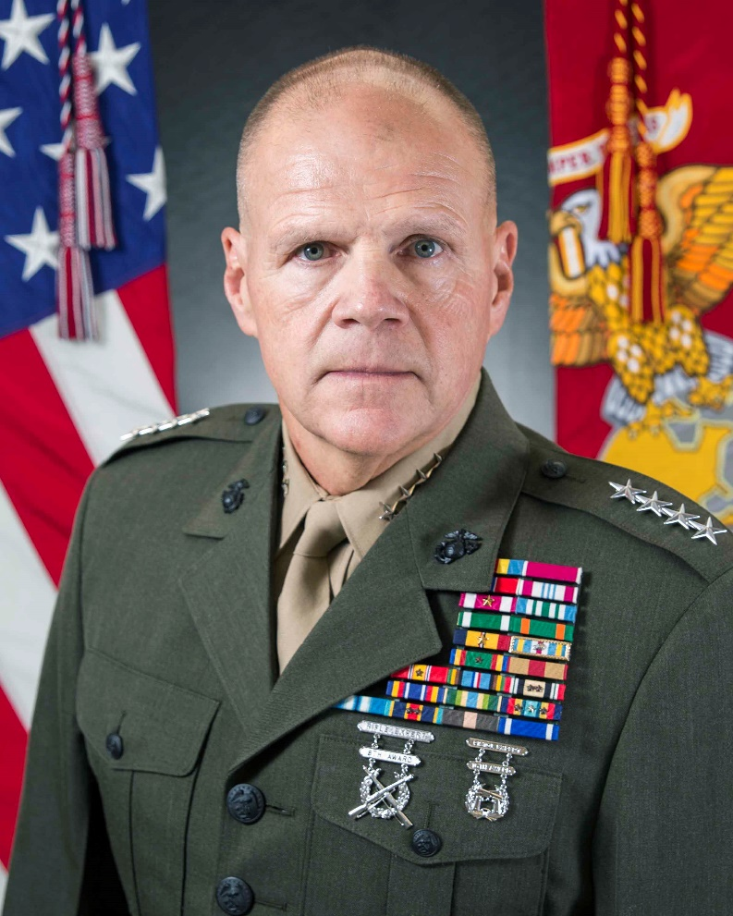
Your Appearance and Demeanor Will Influence Your Outcome
SEAL Team 6 Master Gunnery SGT
Marine Corps Commandant

Slide 14
The Eyes Don’t Tell It All
There are many misconceptions about eye movement or eye contact during interpersonal communications
Neuro Linguistic Programming proponents state that eye movement to the right indicates truthfulness, while movement to the left indicates falsehood
Law Enforcement Interview techniques train investigators to look for eye movements as a “tell”, however many investigators over-simplify the method
These misconceptions are widely held; it is a trivial matter to direct the outcome of an interaction by intentionally misdirecting eye movement to indicate an alternative message
Be consistent, however

Slide 15
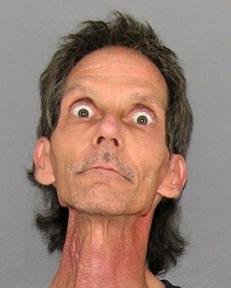
What Are Some of Your Misconceptions?
Here is one of mine:
“Bug-eyed people are crazy.”
Me, 2002
Tell me some of yours

Slide 16
The Truth About Eye Movement
Investigators maintain eye contact with the interviewee or suspect to observe both eye and body movements
The sense of the investigator “looking through you” comes from the habit of experienced investigators using peripheral vision with direct eye contact to catch small gestures, and facial expressions, also known as “micro-expressions”
A discussion of micro-expressions could take up an entire presentation by itself
Briefly, look for inconsistencies, a slight nod when a person denies knowledge of an event. A displeased look when they claim no knowledge of a person.
They eyes may play a role in this, but as part of a larger reaction

Slide 17
The Second Point of Contact is the Voice
In EVERY prolonged communication you will, at some point, engage in verbal communication with the other party, or their representative
Generally, this will occur shortly after eye contact, in the form of a greeting
You method of speech may have a calming or irritating effect on listeners
We’ve all been there, and the clues are obvious
Overcome with practice
An unwillingness to engage in verbal interaction leads to anxiety and awkwardness; this will manifest during the conversation
Look for opportunities to overcome this, small at first, but increasing in scope
Build your confidence, and project it
It is important to get used to the sound of your voice; practice, even if you are alone

Slide 18
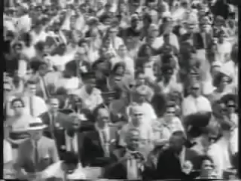
Use Your Voice Effectively
Rate, The Speed at which you speak
Too fast signifies nervousness, also the audience may not understand the message
Too slow signifies boredom and disinterest, which will bleed out to the audience
Aim for middle road, time body movements and gestures to assist you with the tempo (just like a music conductor, but not as flashy)
Pitch and Volume
High and loud, or low and soft, avoid both
Ensure your voice carries, but do not yell
Variety
Speaking in the same tone and volume will either annoy, or bore the listener, possibly both
Use Intelligent Words, and Speak Clearly
Avoid the use of slang, buzzwords, and offensive speech
Understand the meaning and pronunciation of the words you choose
Open your mouth and fully articulate the words, especially vowels
Avoid verbal pauses, such as “um” and “you know” (I probably will be guilty of this

Slide 19
The Most Important Tip While Speaking
BREATHE!
Humans, when stressed tend to breathe very quickly, and when concentrating tend to hold their breath.
Do neither, concentrate on breathing in between phrases
Get a full breath, not a gulp of air, don’t turn it into a stage act
Breathing techniques are used to reduce anxiety, stress, and “fight or flight” reactions
This will lower your overall heartrate and blood pressure
Practice a technique you know, or find one you like
Standard is in through the nose, out through the mouth
If you are not breathing, your brain and muscles are starving for oxygen; you will sound stupid, and feel tired

Slide 20
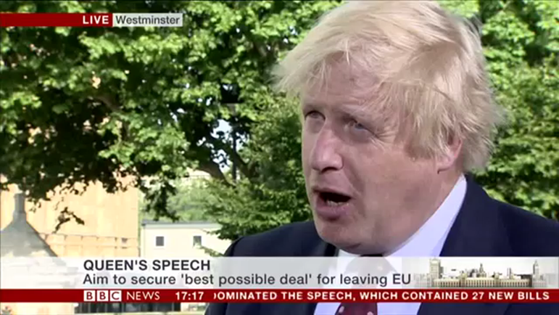
Please, Don’t Be This Guy
Visual, our first point of contact
Looks like he rolled out of bed (or off a park bench) with a camera pointed at his face
Baseline rate of speech is rapid, with a high tone
Some words are slurred, and impossible to understand
Some variety, because this is not a speech, but not enough to form a convincing message
He sounds as though he is pleading his case rather than stating it
Stumbling through words, plenty of verbal pauses
Pattern of speech not in sync with his body movements (more on that upcoming)
Does this interview convince you?
Are your impressions generally positive, or generally negative?
If you don’t sound confident, no one will have confidence in you

Slide 21
Body Language – The Third Point of Contact
Body language is the third, and arguably the most important point of contact in any prolonged interaction
Initial body language is often misleading
Observations of body language, when combined with observations of eye movement and voice, may give clues about a person’s state of mind, intent, or relative level of truthfulness
Establish the other party’s baseline, and use that to progress the conversation in your favor

Slide 22
The Baseline
The baseline consists of several elements
The other party’s natural pose or posture when they are at ease –AND
The other party’s pose in the environment they are currently in
The other party’s normal voice and mode of communicating with it
How the other party’s mannerisms change in response to the environment, questions, and statements
Specifically, what prompted the change, and how it was different from other events
Special Case: If you are in the other party’s area of control, such as their office or home, then the baseline consists of the environment too!

Slide 23
Establishing the Baseline
Establishing the baseline, also known as the default, is a process of thought provoking communication and observations
Remember that initial perceptions and reactions may vary greatly from the baseline
Using open ended questions, which require more than a simple yes or no, is one method to establish a baseline as the person has to think about their answer
In most cases the baseline will emerge (whether it is relaxed or not) within a brief period after the conversation has begun
Think of it as a sort of “settling in”
Shifts from the baseline will indicate an emotional reaction and are often an unconscious response, these manifest as micro-expressions

Slide 24
Recognizing Changes in the Baseline
Richard Nixon’s Resignation Speech
Shift in posture from the opening statement to the second paragraph
Tightening of muscles in cheeks and lips at regular times
Point 1:16, he sneers at the camera
Point 13:40, he smiles, he finds the statement humorous
Point 14:10 what he is saying hits home, watch his reaction in the following moments
Take the time to watch this video on your own, you will find many more examples

Slide 25
Understanding the Changes in Baseline
This is where Logic and Critical Thought comes in
What event or statement caused the reaction?
Is there something about the reaction that is inconsistent from the message?
For example, nodding the head when the other person claims no knowledge of an event or person
How pronounced was the reaction?
Did the reaction shift back to baseline, if so, how long did it take?
Is the reaction reasonable, given the circumstances?
You have to ask yourself questions, and sometimes make assumptions
Warning: some people are not subject to Logic and Critical Thought

Slide 26
Using Your Body Language
Just as you observe the other party’s body language, you need to be cognizant of your own
What message are you sending with your posture, gestures, and eyes?
In the US, we generally prefer front facing, squared shoulders, upright posture, direct eye contact, with visible open hands
Don’t be a statue, move a little, it will relax both you and the listener(s)
The human eye is drawn to color, contrast, and movement; be purposeful but not skittish or quick in your movements
Crossing any part of your body (arms, legs) or facing a way is unconsciously perceived as resistance, or unwillingness to communicate
Closed hands (fists) or flexing of the hands is considered a pre-assault indicator (we’ll touch upon that if we have time)
Be aware of cross-cultural differences
Cultures that perceive direct eye contact as a challenge, or disrespectful
Cultures that maintain close physical proximity as opposed to “arms-length”
Affirmation movements (nodding in agreement) that differ among various cultures

Slide 27
Special Focus - Mirroring
Mirroring is described as the subconscious mimicry of another’s pattern of speech, gestures, body language or attitude of another
As a form of non-verbal communication, this establishes rapport between parties, imparting a sense of agreement and belonging
Mirroring is an effective technique used to influence the other party
After establishing the baseline, choose a posture or pose similar to the other party
As the other party’s body language shifts, change your own slightly to match it
Never make the adoption of a pose, gesture, or posture immediate, ease into it
At a key moment (judgement is paramount here) take control by shifting your body and observing if the other party shifts to match
This could be minutes, or longer, into a conversation, don’t rush it
If the other party observes you mirroring them, they may become offended, or choose to use it to their advantage

Slide 28
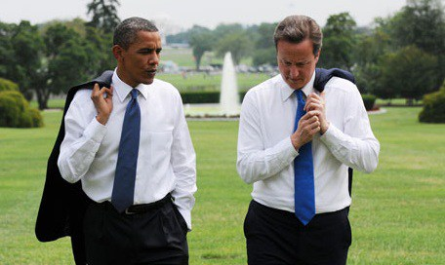
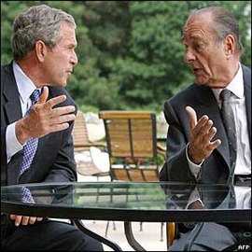
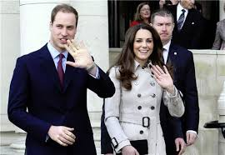
Examples of Mirroring

Slide 29
Physical Contact
Touchy subject for some
Physical contact with another person in prolonged personal communications is inevitable
Handshakes when you first meet
Again, you have to be aware of cultural differences and personal preferences
It is quite possible to be in a situation where no one wants any physical contact with the other party
If physical contact is part of the greeting, make it consistent; don’t shake hands with the males in the room and then hug the females
On the flip side, it is probably not a good idea to hug anyone
Be conservative, in most cases a handshake is sufficient, even after long term interpersonal communications
I can’t coach you on handshakes and bro-hugs; you will have to work that out for yourself

Slide 30
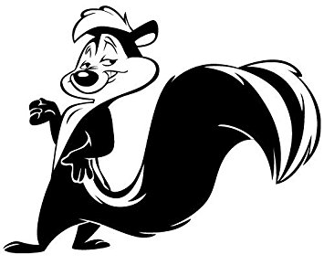
Okay, There Is One More Point of Contact
One thing hardly talked about in any communication setting is the olfactory senses
The sense of smell is a powerful stimulant, positive or negative
It will affect the perceptions others have of you, and affect your perceptions of others
When you are nervous, you perspire, in some cases it is visual, but it is always olfactory
Don’t smell like the entire case in the perfume section, or like you own stock in Axe Body Spray
Middle of the road, or neutral, is a point we have reinforced constantly; it applies here as well
But, this also applies to the environment; avoid areas of olfactory overload, and, if you find yourself in one, find your happy thought and concentrate on it to avoid reacting

Slide 31
Pre-Assault Indicators
The expectation or contemplation of physical violence is a point of stress for most humans
We deal with this stress in various ways, but it invariably manifests through physical indicators
May appear in no specific order
Because we have not entirely lost our survival instinct, we are keyed to this type of behavior
Recognizing it, when it begins to manifest, will help keep you safe
And, you will learn not to display certain behaviors which may influence others in a negative way

Slide 32
Pace, Proximity, and Positioning
“Walking with a purpose”
Also known as a targeting pace, the subject is approaching in a direct manner, focused, tunnel vision
By itself could mean they just need your attention, pay attention to other indicators
Closing the distance
Invading personal space
Circling behavior, be certain it does not spiral, or an attempt to get behind you
Sweeping behavior, walks away and then back towards you
Positioning
Are they trying to work their way behind you or to a perceived weak side?
Are there objects between you and the subject?
Are YOU backing that person into a corner or to a confined physical location?

Slide 33
Hands and Eyes
What are the hands doing?
Are they both visible, is one concealed? Are they both concealed?
Are they presenting one hand or both hands in a non threatening manner?
A concealed hand may be an indicator of a concealed weapon
“Ritualistic” movement such as flexing the hands and clenching the fists (especially repeatedly), rubbing the hands or arms, stretching or flexing the forearms (fight or flight response)
What are the eyes doing?
Is their gaze locked on a specific item on or portion of your body?
Do they look like they “checked out” or have tunnel vision
Dilated pupils or wide eyed gaze (indicator of fight or flight response)
Narrowing of the eyes

Slide 34
Shoulders, Neck, and Head
Similar ritualistic behavior in the shoulders or neck, such as flexing and awkward stretching, or rolling the shoulders
Tightening of the lips/mouth, flexing of the neck, clenching and tightening of the jaw muscles
“Fighters’ Stare,” lowering the head but keeping the eyes on you (protecting the chin)
Only slight lip movement during speech or talking with clenched teeth
Flared nostrils (subconscious reaction to pull more oxygen)
“Head pecking” at you while talking

Slide 35
Posture
Sudden changes in posture: relaxed to tense, tense to relaxed
Shifting of the weight from one side to the other, or adopting a fighter’s stance with one foot positioned ahead of the other
“Planting” oneself may mean resistance, but is not necessarily an indicator to violence
Special note: If the other person is trained in unarmed fighting, it will generally manifest in their posture and stance

Slide 36
And Now, The Experiment, Explained
Everyone, without changing your body position, look around the room at each other
How many of you are sitting like Brendan?
At the beginning of this presentation, both Brendan and I established a baseline for the audience
For me, establishing the baseline was necessary to tell how I was doing
Brendan however used this opportunity to take control of the baseline, and began inserting gestures, poses, and other non-verbal messages as I spoke
You were paying attention to me, but you also saw him
In our prep time, I instructed him exactly how I wanted him to sit, react, and gesture, with the goal of you beginning to mirror his actions

Slide 37
Summary
Today we talked about communication techniques with the goal of influencing the outcome over an extended period of time
We discussed, briefly, the importance of learning to communicate effectively
We discussed how these methods may be used to detect attempts to influence you
We discussed points of contact, their individual importance, and how they all blend together
We discussed pre-assault indicators, how to recognize them, and how to avoid expressing them when we do not intend to

Slide 38
Questions?
If you want a copy of the slide deck, it will be available on Dropbox and Google Drive
See me after the presentation, and I will send you the link
Critique and feedback is welcomed, and actively sought
Thank you!

Slide 39
Works Cited
Brian D. Fitch, Ph.D, The Truth About Lying: What Investigators Need to Know, Federal Bureau of Investigation, https://leb.fbi.gov/articles/featured-articles/the-truth-about-lying-what-investigators-need-to-know
Communication in the Real World: An Introduction to Communication, University of Minnesota Libraries Publishing
David Matsumoto, Ph.D.; Hyi Sung Hwang, Ph.D.; Lisa Skinner, J.D.; and Mark Frank, Ph.D, Evaluating Truthfulness and Detecting Deception, Federal Bureau of Investigation, https://leb.fbi.gov/articles/featured-articles/evaluating-truthfulness-and-detecting-deception
David Matsumoto, Ph.D., Lisa G. Skinner, J.D., and Hyisung C. Hwang, Ph.D, Reading People: Behavioral Anomalies and Investigative Interviewing, Federal Bureau of Investigation, https://leb.fbi.gov/articles/featured-articles/reading-people-behavioral-anomalies-and-investigative-interviewing
Interrogation Best Practices, Federal Bureau of Investigation, High Value Detainee Interrogation Group, August 26, 2016, https://www.fbi.gov/file-repository/hig-report-august-2016.pdf
Interrogation, a Review of the Science, Federal Bureau of Investigation, High Value Detainee Interrogation Group, September 2016, https://www.fbi.gov/file-repository/hig-report-interrogation-a-review-of-the-science-september-2016.pdf
Richard Wiseman, Caroline Watt, Leanne ten Brinke, Stephen Porter, Sara-Louise Couper, and Calum Rankin, The Eyes Don’t Have It: Lie Detection and Neuro-Linguistic Programming, US National Library of Medicine, National Institutes of Health, July 11, 2012, https://www.ncbi.nlm.nih.gov/pmc/articles/PMC3394779/
Vocal Presentation Skills, New Your Eye and Ear Infirmary of Mount Sinai, http://www.nyee.edu/patient-care/otolaryngology/voice-swallowing/therapy/public-speaking-tips

